Slide 1

IPL Analysis
Season-wise Team & Player Performance Metrics
Asiya Shaikh

Slide 2
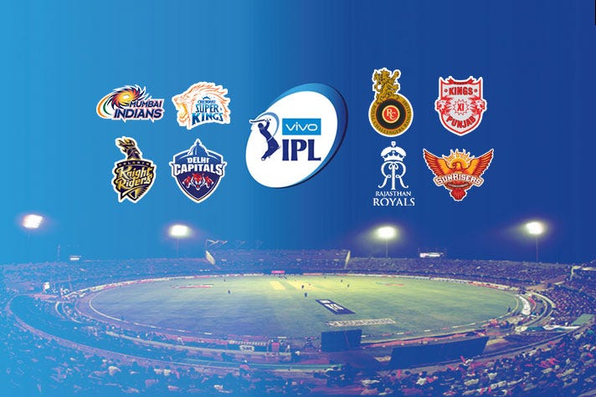
Agenda
Introduction to IPL
Problem Statement
Database Schema
Data Description
Methodology
Player Performance Metrics
Venue-Based Insights
Team Performance Analysis
Season-Wise Trends
Future of IPL
References

Slide 3

Introduction to IPL: India's Premier T20 League
Indian Premier League (IPL) is a professional Twenty20 cricket league in India, founded by the BCCI in 2008. It features franchise teams representing major cities, with players from across the globe. Known for its fast-paced format and high entertainment value, the IPL is one of the most-watched cricket leagues worldwide.
This analysis explores team and player performances across IPL seasons using SQL-driven insights. It highlights match-winning strategies, key performers, venue-based trends, and crucial game phases such as powerplay and death overs. The goal is to identify patterns that can help teams make smarter decisions in team selection, in-game tactics, and long-term strategy.

Slide 4

Problem Statement
You are hired as a sports data analyst by RCB where the team is looking for top-performing and reliable players to win tournaments, considering both on-field performance and value for money in mega player auction of 2017.
Your task is to come up with strategies/suggestions regarding selecting the best-performing players and optimizing player auction investments.

Slide 5
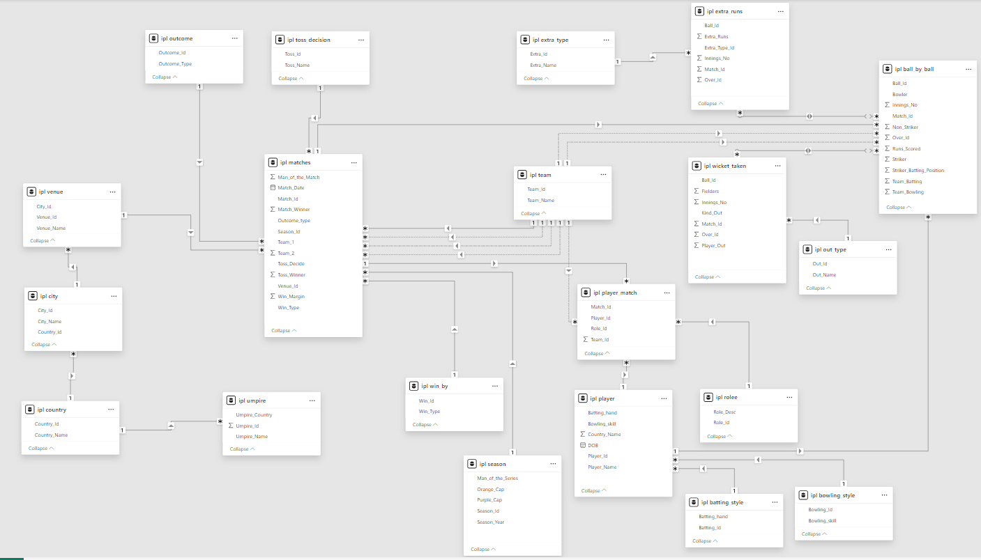
Database schema

Slide 6
Data Description
The analysis is based on a rich and comprehensive IPL database consisting of 20+ interlinked tables covering various aspects of the league:
Match Data: matches, season, venue, outcome, win_by, toss_decision
Ball-Level Data: ball_by_ball, extra_runs, wicket_taken
Player & Team Info: player, team, player_match, rolee, batting_style, bowling_style
Location Data: city, country, umpire
Extras and Dismissals: extra_type, out_type
This detailed schema allows for deep insights into player performances, team strategies, venue patterns, and seasonal trends.

Slide 7
Methodology
While exploring the dataset, I began by analyzing the structure, checking for any duplicates or null values. I then examined the tables and their interrelationships to understand how they were connected. To answer the various queries, I made extensive use of SQL statements such as SELECT, GROUP BY, and ORDER BY.
When data from multiple tables was required, I applied JOIN operations to combine relevant information effectively. I also used aggregate functions like SUM, AVG, COUNT(DISTINCT), MAX, and MIN to derive meaningful metrics.
Additionally, ranking functions were used to rank players based on parameters such as batting average and strike rate. On the structural side, I used DDL commands like CREATE to define tables, and DML commands like INSERT and UPDATE to manipulate data.
Overall, this project involved a wide range of SQL functionalities that helped transform raw data into actionable insights for cricket performance analysis.

Slide 8
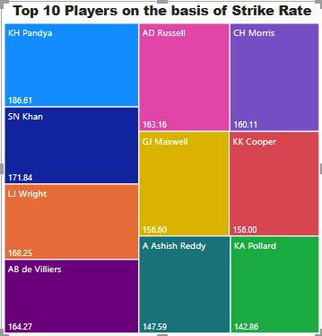
Player Performance Analysis
This chart showcases the top 10 players with the highest strike rates over the last four IPL seasons. Strike rate is a crucial performance metric in T20 cricket, reflecting a player's ability to score runs quickly. The featured players have demonstrated exceptional consistency in accelerating their team’s innings.
These high strike rates often influence match outcomes, especially during powerplay and death overs. This analysis helps identify key finishers and aggressive top-order batters. It also offers insights into batting strategies adopted by different teams.

Slide 9
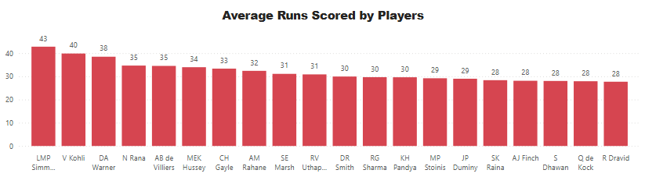
Top 20 Batsmen by Average Runs (All Seasons)
This slide highlights the top 20 batsmen based on their batting averages across all IPL seasons. The batting average is computed as total runs scored divided by the number of times the player has been dismissed, reflecting both performance and consistency. Featuring only players with a minimum number of matches or balls faced ensures statistical relevance. These top performers have demonstrated sustained excellence, contributing significantly to their teams' batting strength over the years

Slide 10
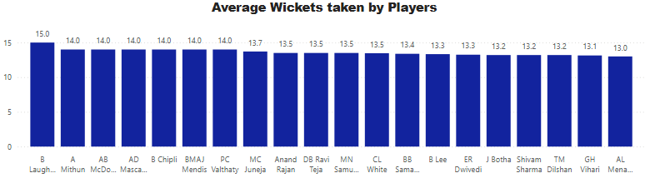
Top 20 Bowlers by Average Wickets (All Seasons)
This slide presents the top 20 bowlers ranked by their average number of wickets taken per match throughout all IPL seasons. The average is calculated by dividing the total wickets taken by the number of matches played, giving insight into each bowler’s impact and consistency. Only bowlers meeting a minimum threshold of matches are considered to ensure reliability. These players have been pivotal in restricting opponents and turning games with their bowling performances.

Slide 11
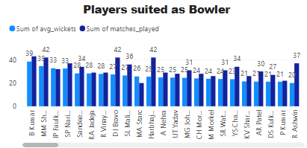
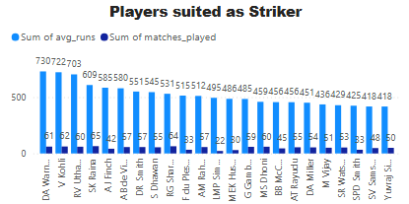
Identifying Venue-Specific Player Strengths
The first chart shows average wickets taken alongside the number of matches played by each bowler, helping us identify bowlers who consistently perform well in certain conditions.
The second chart displays average runs scored along with matches played by each batsman, revealing players whose batting style is particularly effective at specific venues.

Slide 12

Key Parameters for Selecting Players
When selecting players for a cricket team, both batting and bowling metrics are crucial for overall team performance. Batting metrics such as total runs scored, batting average, and strike rate provide insights into a batter’s consistency, productivity, and ability to accelerate scoring. Similarly, for bowlers, total wickets taken, bowling average, economy rate, and strike rate (balls per wicket) help assess their wicket-taking ability, consistency, and ability to control the game. Focusing on these parameters ensures balanced team selection, enhancing both batting depth and bowling effectiveness.

Slide 13
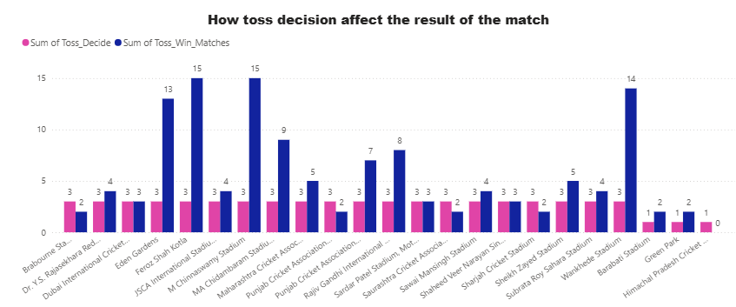
Impact of Toss Decision
This analysis examines the effect of the toss decision on match outcomes, exploring whether winning the toss gives a team a greater advantage, and if this effect is specific to certain venues. By calculating the toss win percentage for each venue, we can determine if the toss decision has a consistent impact across all locations or if specific venues amplify the importance of winning the toss.

Slide 14
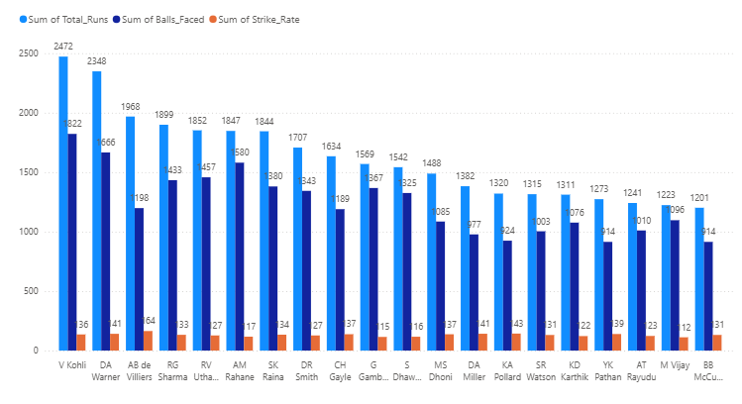
Top 20 Best Fit Players for the Team
This analysis identifies the top 20 players best suited for the team by evaluating both batting and bowling performance. We use the ball_by_ball, player, and wicket_taken tables to calculate key batting metrics like total runs, balls faced, times out, batting average, and strike rate, and for bowling metrics like total wickets, economy rate, and strike rate. The query filters for players with 100+ balls faced for batsmen and evaluates bowlers based on their wicket-taking ability. Players are then ranked by their overall performance in both batting and bowling to highlight those who bring balanced contributions to the team.

Slide 15
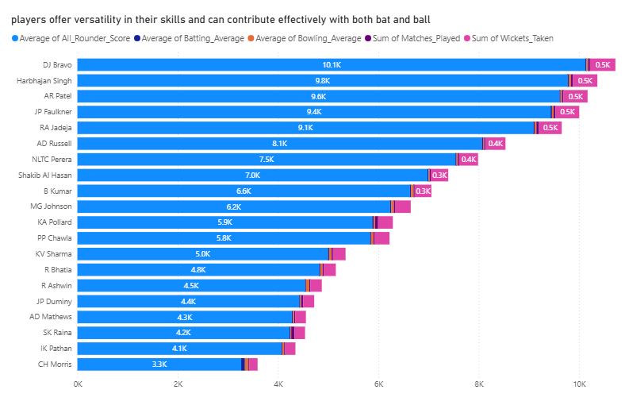
Identifying Versatile All-rounders
This analysis identifies players who offer versatility by contributing effectively with both bat and ball. By aggregating key batting and bowling metrics, such as total runs scored, batting average, wickets taken, and bowling average, we calculate an all-rounder score for each player. The query combines data from multiple sources—player, ball_by_ball, wicket_taken, and matches—to assess their performance across both disciplines. Players with significant participation and balanced contributions are ranked to highlight the top 20 all-rounders. Visualization of these all-rounders' stats would clearly show their dual impact, making it easier to spot key players who can strengthen the team.

Slide 16
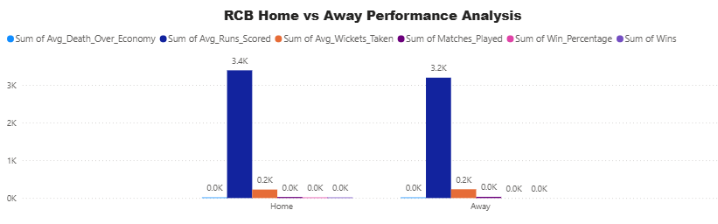
Maximizing Home-Ground Advantage for RCB
RCB can leverage the home-ground advantage at M. Chinnaswamy Stadium to enhance team performance and increase their chances of success. Given the high-scoring nature of the stadium, RCB should strengthen their bowling attack by investing in death-over specialists and spinners who can control run flow with variations. For batting, they should maximize power play exploitation by selecting aggressive top-order batsmen capable of taking advantage of the pitch's conditions. The team should tailor their strategies to suit venue conditions, focusing on matchups and rotational selection for bowlers. Leverage the crowd support to apply pressure on opponents and build confidence. Finally, RCB should analyze opposition weaknesses at home and use those insights to exploit vulnerabilities, especially when opponents have poor away records at Chinnaswamy.

Slide 17
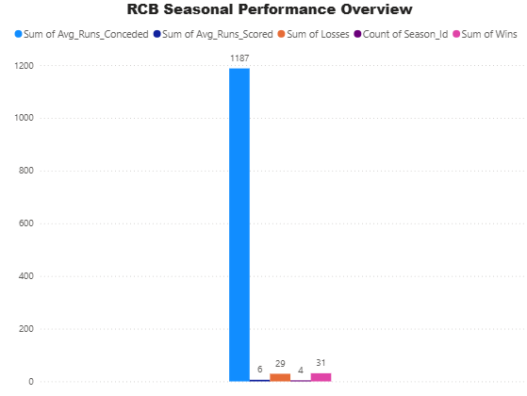
RCB's Past Season Performance
Royal Challengers Bangalore's (RCB) performance over multiple seasons by focusing on key metrics such as total wins, losses, average runs scored, and average runs conceded. By calculating these parameters, we can identify patterns and trends that influence RCB's success or lack thereof in various seasons. The data provides insights into which aspects of their performance, whether batting or bowling, need improvement. For example, high average runs conceded or a weak middle-order batting performance in certain seasons may have contributed to their inability to win the trophy. This analytical approach will help the team focus on areas needing attention and refine their strategies for future seasons.

Slide 18
Strategic Recommendations for RCB Ahead of the Mega Auction
Before heading into the mega auction, RCB should strategically focus on specific areas to strengthen their squad. First, prioritizing death-over batting power with players who excel in the final overs and have high strike rates will be vital for finishing games strongly.
In bowling, acquiring economical bowlers with low economy rates will help control the game and apply pressure, especially during key moments. RCB should also aim to bring in all-rounders who can contribute consistently with both bat and ball, ensuring a balanced team.
A blend of experience and youth will provide stability and fresh energy, while targeting middle-order batters with a track record of consistency under pressure will help address vulnerabilities. Lastly, focusing on spin options for middle overs will allow RCB to dominate the game in the crucial overs 7–15

Slide 19

Future of IPL: Predictions & Growth
The IPL is poised to become even more competitive with the introduction of new teams and the rise of emerging young talent, each with their distinct batting and bowling styles.
As the league continues to attract international players, it is expected to further elevate the level of play, inspiring a new generation of cricket fans. With increasing fan engagement, both in stadiums and online, the IPL’s global impact is evident.
The growing fan following signifies not only the league’s success but also its bright future in shaping the global cricketing landscape. The next few seasons will likely witness thrilling contests, more international players, and larger-than-ever fan bases.

Slide 20

Acknowledgments & References
Data for this analysis was provided by Newton School. Additional insights and knowledge on cricket terms were sourced using Google. The following applications were employed for the project:
Microsoft Word for documentation.
Microsoft PowerPoint for creating the presentation.
Power BI for visualizations.
SQL for querying and data extraction.

Slide 21


